Slide 1
Basics of ML and DL using Python
-Adithya Thonse

Slide 2



About Me
Electronics Engineer with background in Deep Learning for Embedded Applications
Expertise in TinyML
Vision Applications
Predictive Maintenance
Real Time Anomaly Detection
4 years experience at Texas Instruments
Trekking Enthusiast, Gym Freak, Cyclist

Slide 3
Generic Info about this course
Entirely taught using jupyter notebooks. Using Google Colab
Pre-requisite: Basic understanding of programming.
Course material available at GitHub
Includes course teachings - Course Teaching- Python and ML
And self practice notebooks - Python_Basics_Practice
Concepts will be taught via a single consolidated presentation
You can mail me anytime at: adithya.t@intellipredikt.com

Slide 4
ML Ideology -1

Slide 5
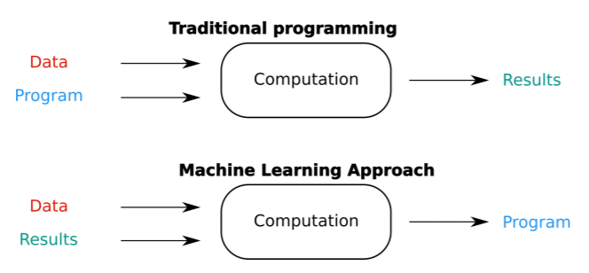
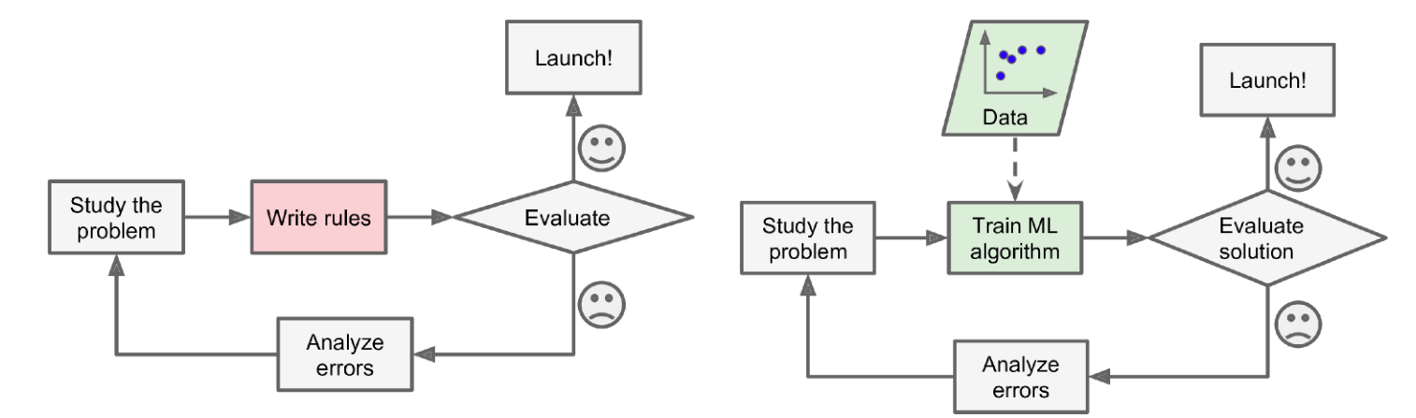
Machine Learning Process
Traditional Approach
ML Approach

Slide 6

Machine Learning Workflow
Frame the ML problem by looking at the business need
Identify subproblems
Establish baselines
Define what is success?
Gather the data and do Data Munging/Wrangling
Explore the data – Pandas, Numpy, Matplotlib
Clean data and prepare for the downstream ML models - Preprocessing
Explore different models, perform V&V and shortlist promising candidates – SciKit Learn/TensorFlow/PyTorch
Fine-tune shortlisted models and combine them together to form the final solution – Bagging/Boosting/Voting Classifiers
Present your solution
Say a story with the data – PowerPoint/Tableau/ PowerBI
Deploy – Embedded Hardware (MPU?MCU), Cloud Platform
Monitor performance
Gather updated data
Repeat 1-5

Slide 7
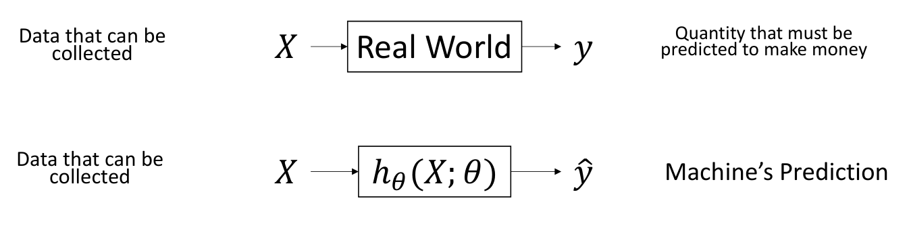
Mental Model of ML

Slide 8
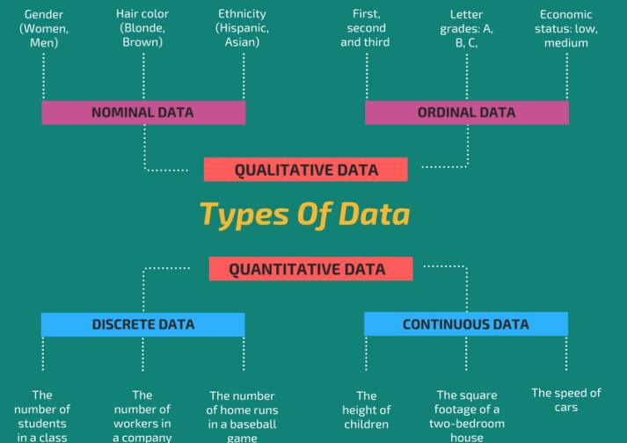
Types of Data (Top Level)

Slide 9
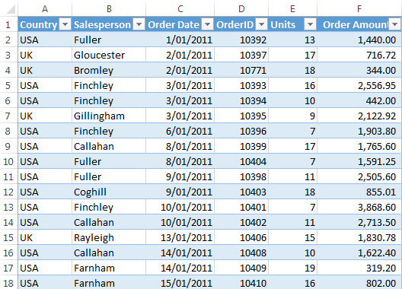
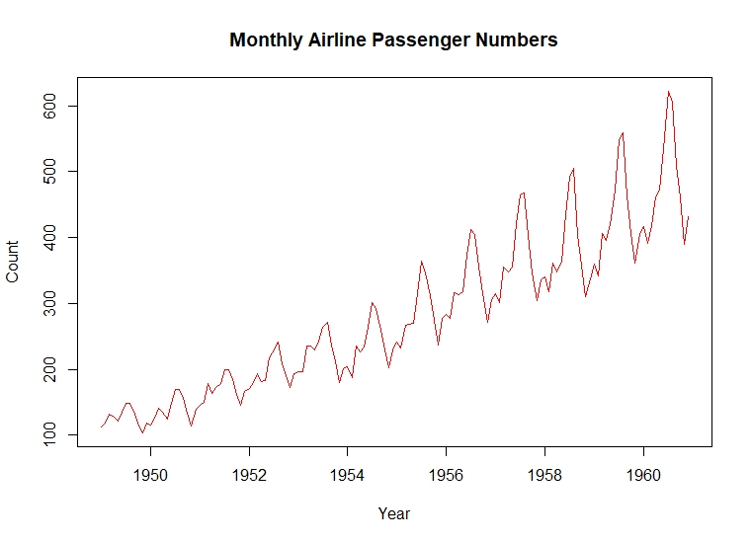
Types of Data (detailed-1)
Tabular Data
Most common form
Arises in almost all business use cases
Usually number of data points x features
Timeseries Data
Tabular but at different times (a logical ordering in time)

Slide 10
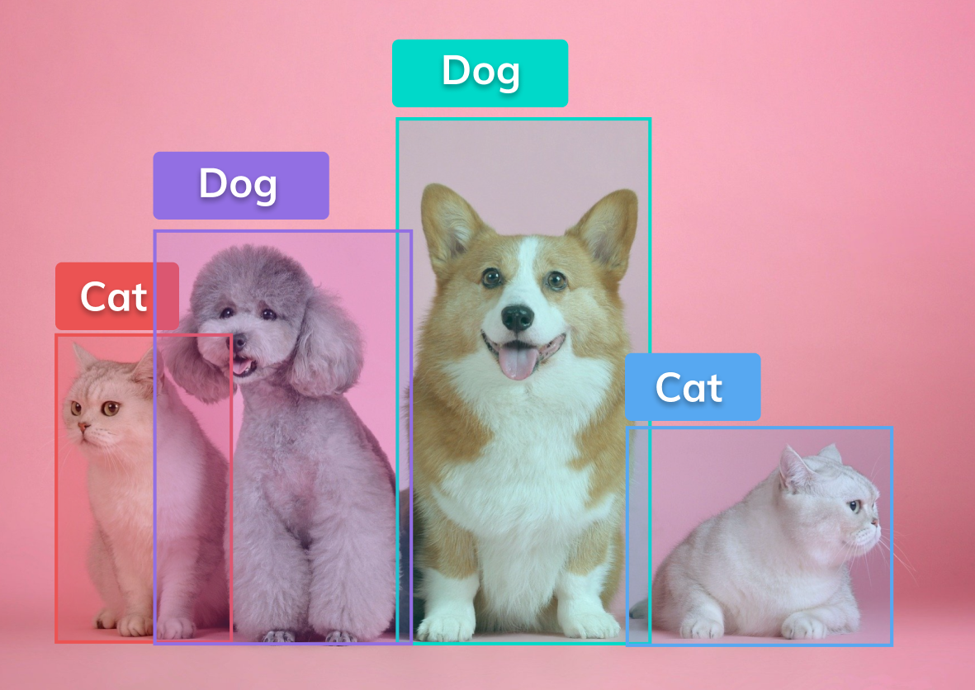

Types of Data (detailed-2)
Image Data
Increasing in recent years
Usually number of data points x height x width x sensor channels
Time series of image data is video data
Vision Tasks
Text Data
Language tasks
Usually text corpus – Needs to be converted to number – How?

Slide 11
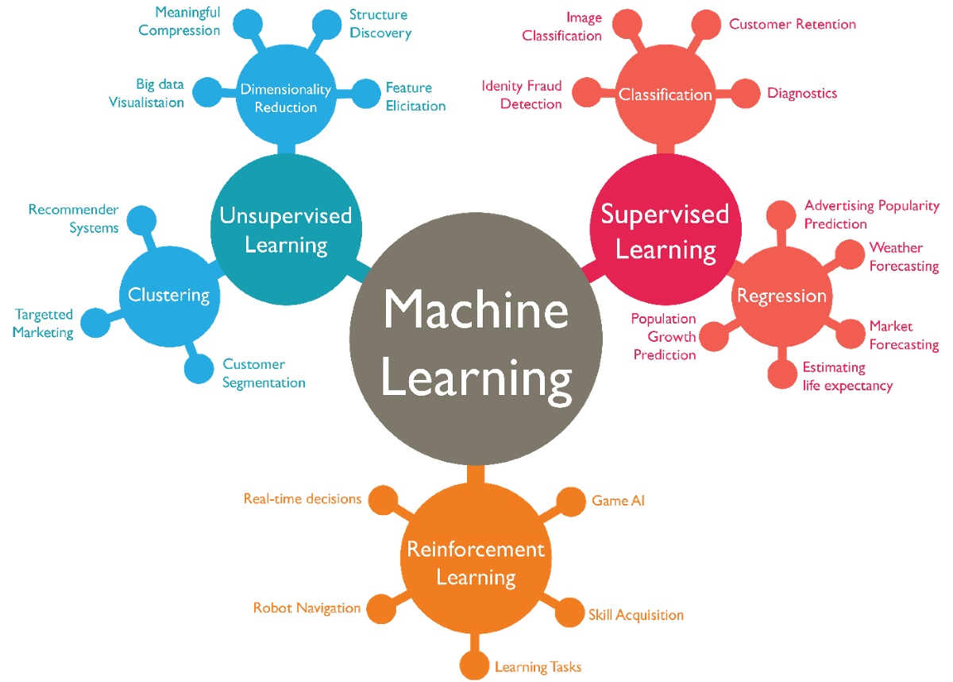
What path to choose?

Slide 12
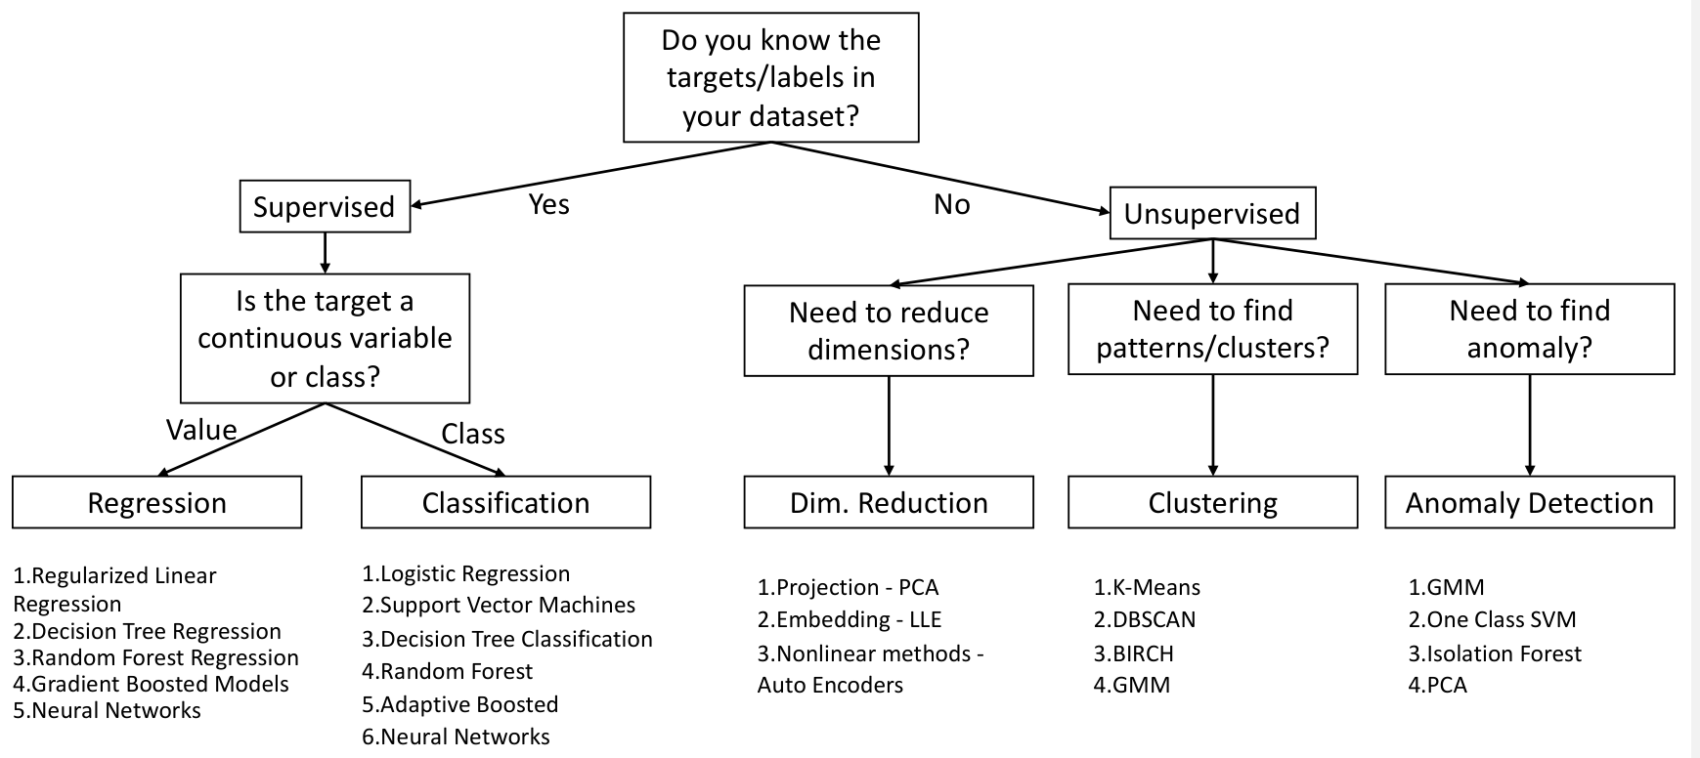
Overall Picture

Slide 13
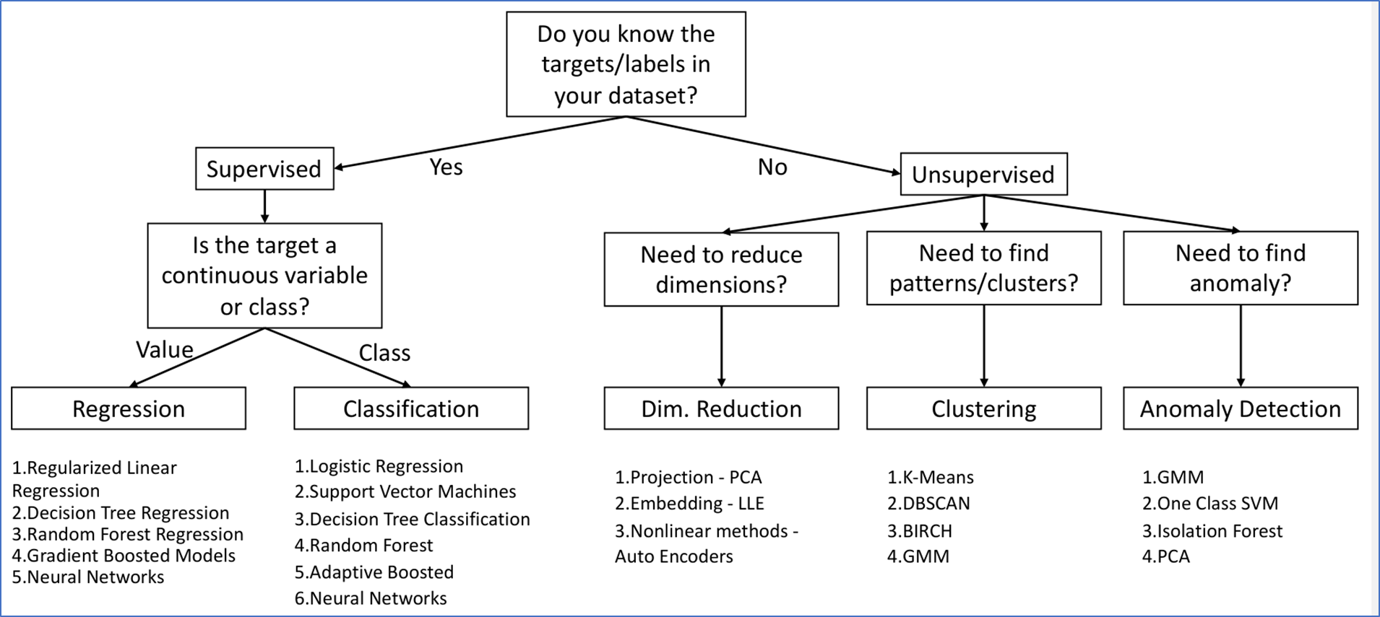
What ML method should I choose?
Predict the range of an Electric Vehicle based on data collected on correlation of battery charge and range.
Answer:
Predict the type of road (highway/potholed/offroad etc) the vehicle is currently on based on data which has a relation between vibration measurements and road type.
Answer:
Compress 20 sensor measurements captured by the car into a 2 dimensional space for predicting accident proximity
Answer:
Group vehicles into 2-wheeler/ hatchback/ /sedan/SUV/truck etc given just the wheelbase dimensions
Answer:
Figure if something is wrong with the engine based on the sound it makes.
Answer:

Slide 14
What ML method should I choose?
Predict the range of an Electric Vehicle based on data collected on correlation of battery charge and range.
Answer: Regression
Predict the type of road (highway/potholed/offroad etc) the vehicle is currently on based on data which has a relation between vibration measurements and road type.
Answer: Classification
Compress 20 sensor measurements captured by the car into a 2 dimensional space for predicting accident proximity
Answer: Dimensionality Reduction
Group vehicles into 2-wheeler/ hatchback/ /sedan/SUV/truck etc given just the wheelbase dimensions
Answer: Clustering
Figure if something is wrong with the engine based on the sound it makes.
Answer: Anomaly Detection

Slide 15
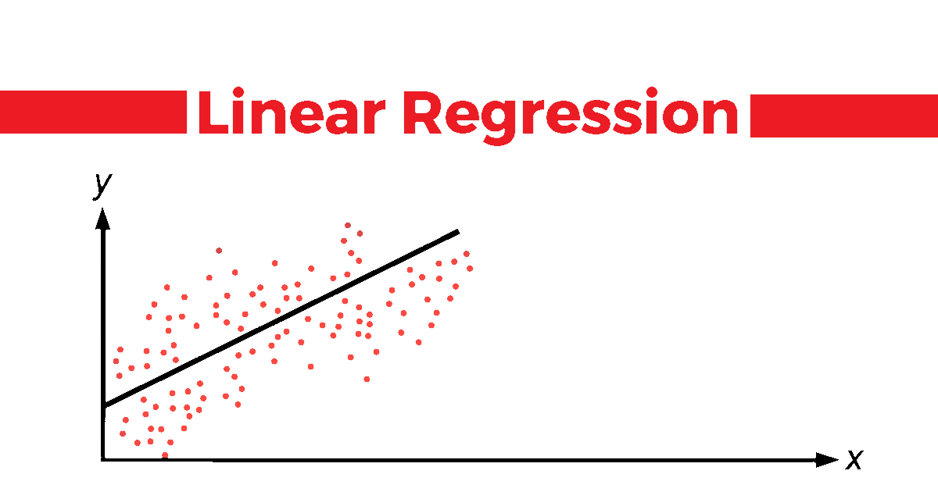

Slide 16
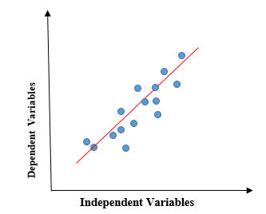
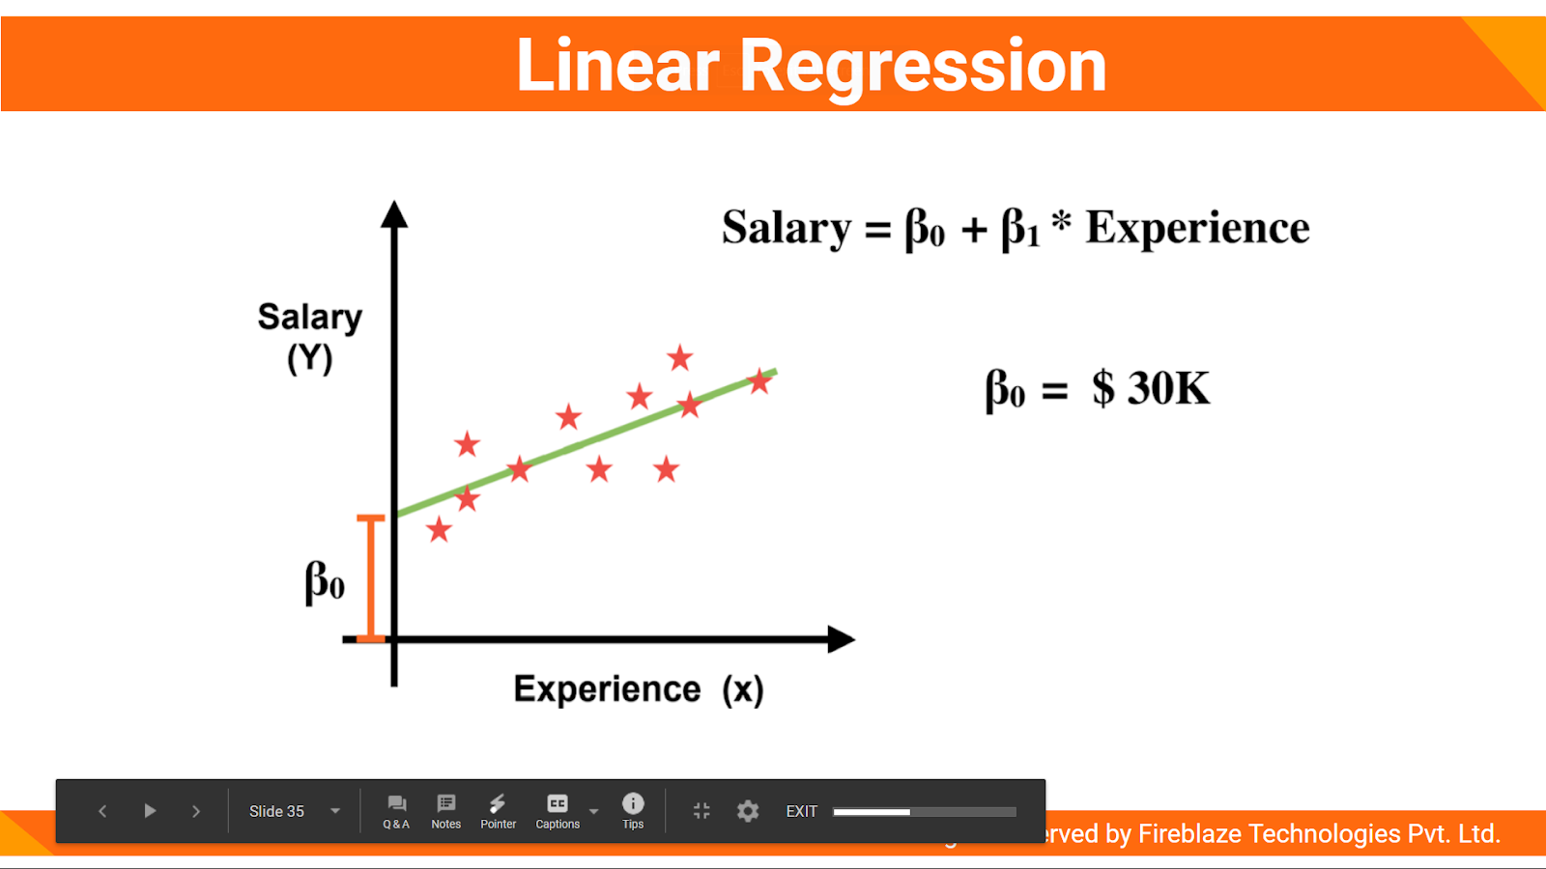
Understanding Linear Regression
Linear regression shows the linear relationship between the independent variable (X-axis) and the dependent variable (Y-axis), consequently called linear regression.
If there is a single input variable (x), such linear regression is called simple linear regression.
Predict the value of a continuous variable in a supervised setting

Slide 17
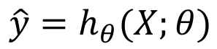
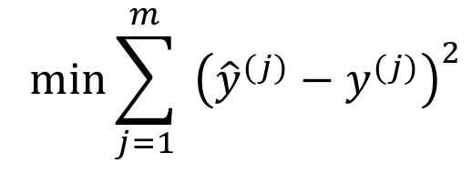
Mathematical understanding
Variable with a hat, y^ is usually the prediction from a model
ℎ is called the hypothesis, or the ML Model parametrized by 𝜃
𝜃 can be calculated, estimated or learned from data by solving the optimization problem:
Mean Square Error:

Slide 18
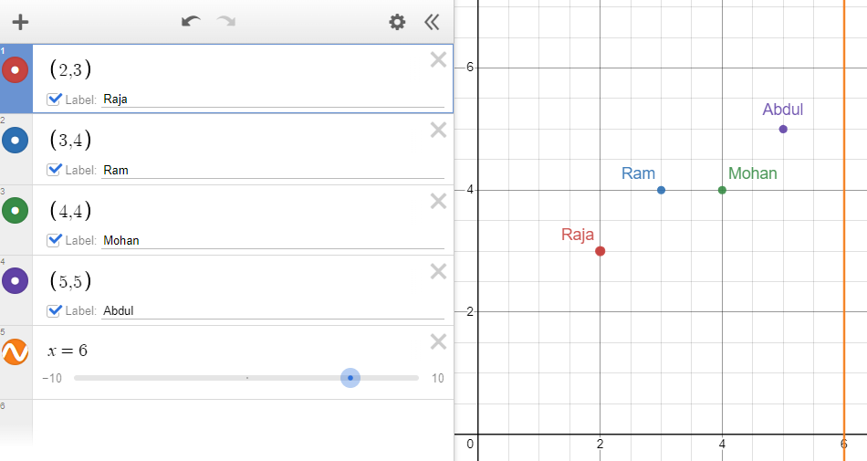
An example
Design a linear regression model to predict the value of medals won by a performer (Roy) based on years of practice
Performer | Years of practice (Independent Variable, x) | Medals won (Dependent variable, y)
Raja | 2 | 3
Ram | 3 | 4
Mohan | 4 | 4
Abdul | 5 | 5
Roy | 6 | ?

Slide 19
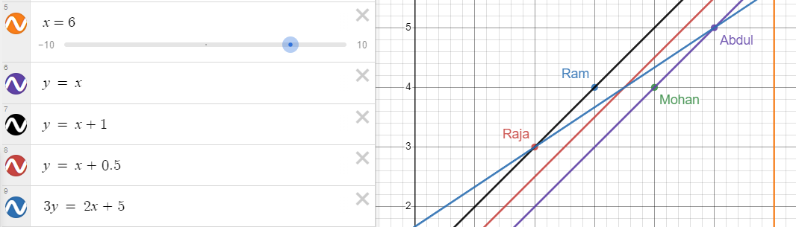
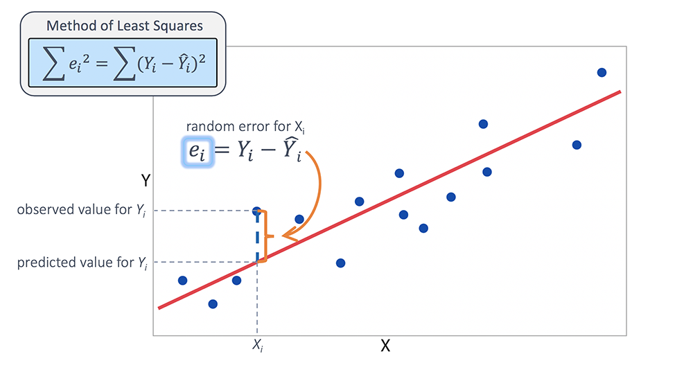
An example

Slide 20
Why can’t we just solve the optimization problem?
Solving this equation (QR- Cholesky method/ SVD) is O(mn²)
square in the number of features, and linear in the number of data points
If we increase features by a factor 2, then computational cost increases by a factor 4.
Both the Normal Equation and the SVD approach get very slow when the number of features grows large (e.g., 100,000).
As they are linear in the number of data points, they can handle large training sets efficiently, provided data can fit in memory.
We need a better optimization algorithm when train data is large.

Slide 21
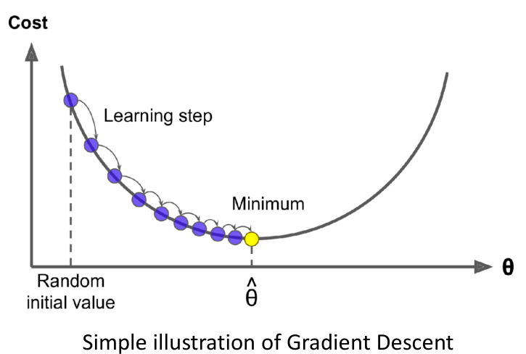
Gradient Descent
Suppose you are lost in the mountains in a dense fog, and you can only feel the slope of the ground below your feet.
A good strategy to get to the bottom of the valley quickly is to go downhill in the direction of the steepest slope.
This is exactly what Gradient Descent does: it measures the local gradient of the error function with regard to the parameter vector 𝜃, and it goes in the direction of descending gradient.
Once the gradient is zero, you have reached a minimum!

Slide 22
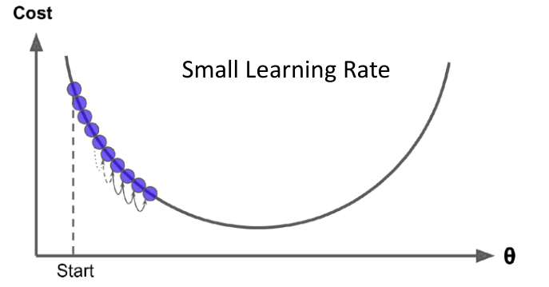
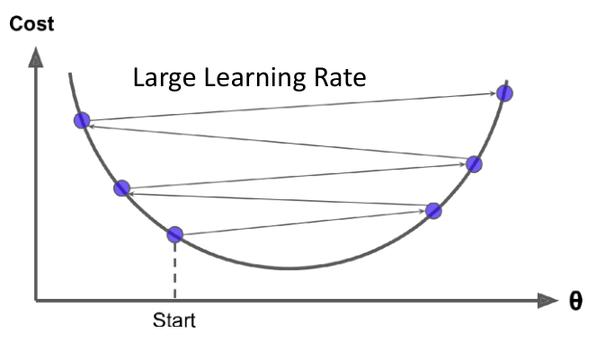
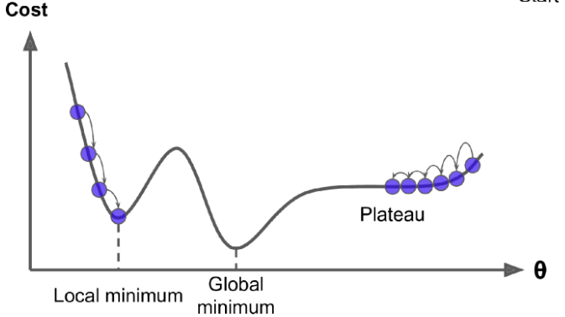
Gradient Descent
Gradient Descent may miss global minima
Very slow in a Plateau
Problem Scaling Issues
To ensure fast convergence, use scaled features

Slide 23
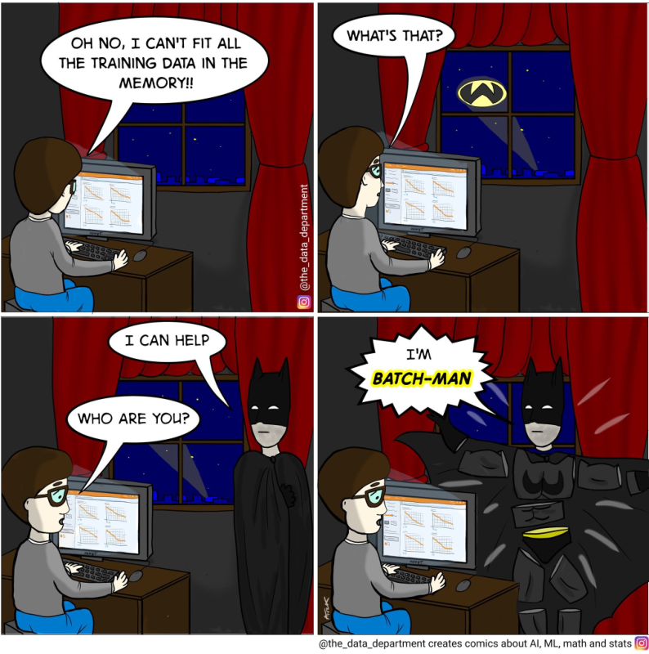
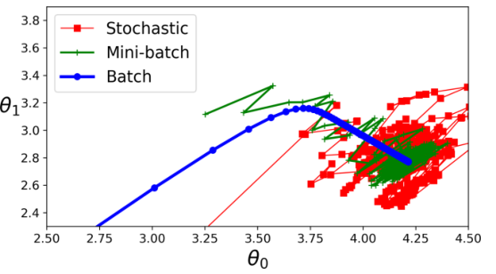
How do I solve this Gradient Descent problem!
Woohoo! Linear regression solved!

Slide 24
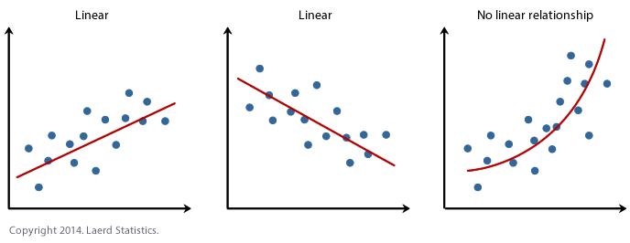
Sneak peek into Polynomial regression
The key property of our Linear Model so far is that the loss function that is minimized (the obj. function) is linear in the parameter 𝜃 (the decision variable) – i.e not ‘x’
The same ideas that we have discussed so far can be used even when the input-output relationship is nonlinear.

Slide 25
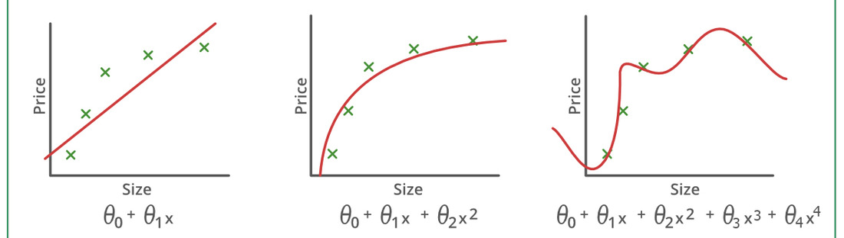
How well am I fitting the curve?
It is up to us to decide the number of features (‘x’) to use to fit the data.
Using a low degree (may) lead to underfitting.
Low computational cost, high error
Using a high degree (may) lead to overfitting.
High computational cost, low error

Slide 26
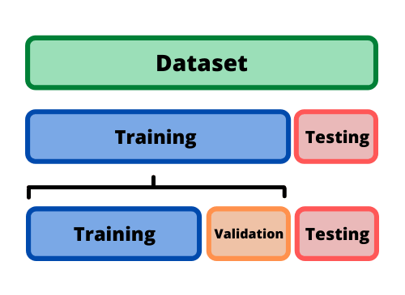
Splitting the dataset
To test our model’s performance, we separate out a ‘Test Set’ which is never seen by the model until evaluation.
The training data, however can be split for validation to better the model’s performance.

Slide 27
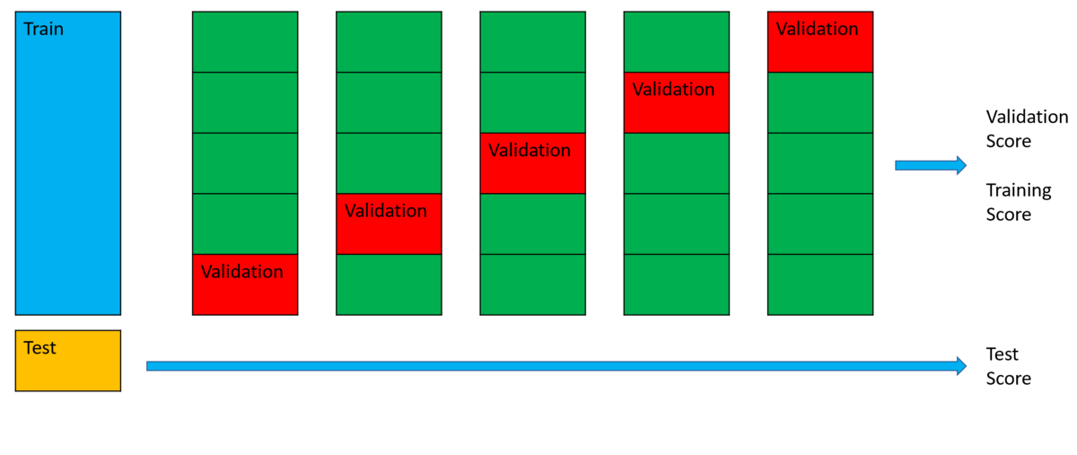
How to know if you are overfitting or underfitting?
Answer 1: Cross-Validation
If a model performs well on the training data but generalizes poorly according to the cross-validation metrics, then your model is overfitting.
If it performs poorly on both, then it is underfitting.

Slide 28
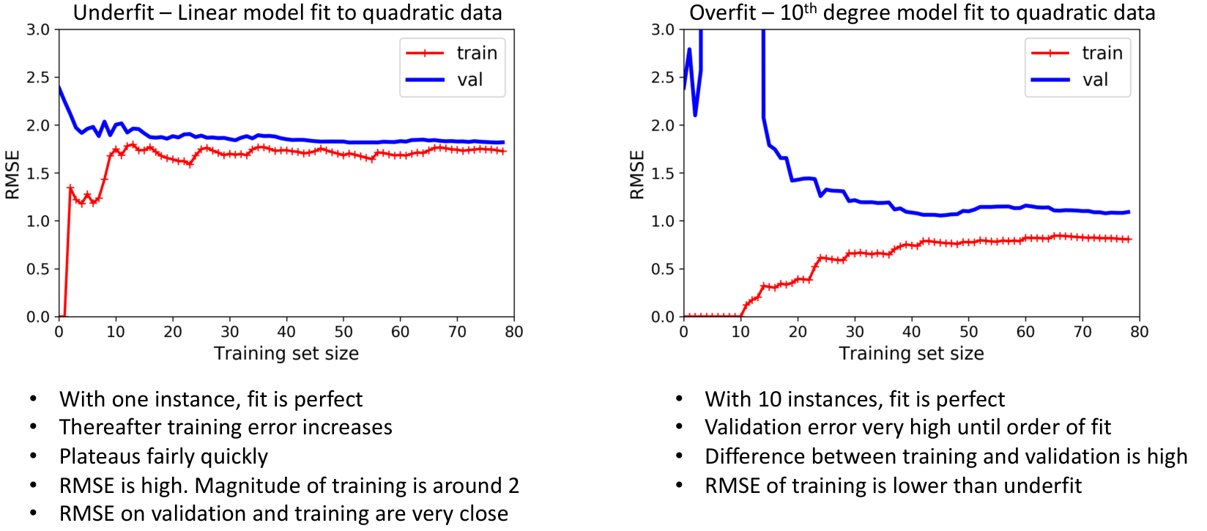
How to know if you are overfitting or underfitting?
Answer 2: Learning Curves
Plots of the model’s performance on the training set and the validation set as a function of the training set size (or the training iteration)

Slide 29
Bias and Variance
A model’s generalization error can be expressed as the sum of three very different errors:
Bias: due to wrong assumptions, such as assuming that the data is linear when it is quadratic.
A high-bias model likely underfits the training data.
Note: This bias is not the bias-term/intercept.
Variance: excessive sensitivity to small variations in the training data.
A model with many degrees of freedom (such as a high-degree polynomial model) is likely to have high variance and thus overfit the training data.
Irreducible Error: Due to inherent noise in the data
Error = Bias² + Variance + Irreducible Error

Slide 30
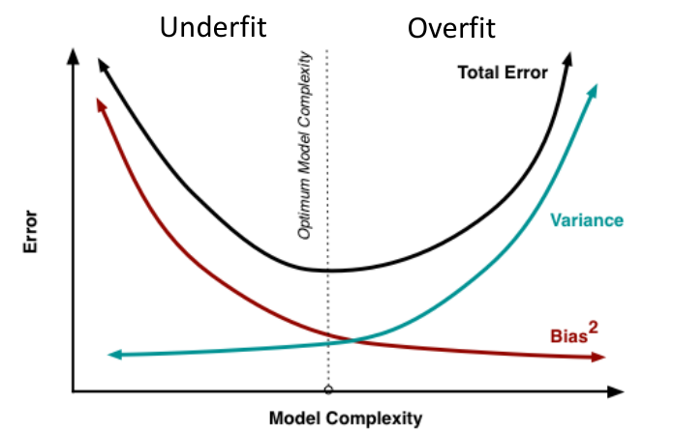
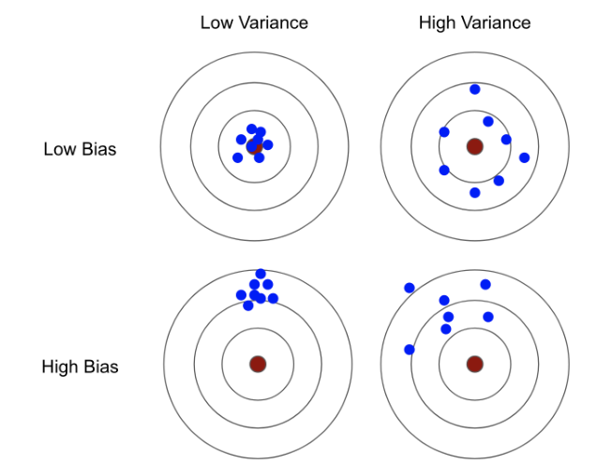
Bias-Variance tradeoff
Increasing a model’s complexity will increase its variance and reduce its bias.
Reducing a model’s complexity will reduce its variance and increase its bias
Bias: Error from erroneous assumptions in the model
High bias -> underfitting
Model has limited flexibility to learn
Analogy: Overly simplistic assumptions about people make you a biased person
Variance: Error from sensitivity of model to small perturbations in training data
High variance -> overfitting
Model has too much flexibility to learn
If you have a lot of data and over complex model, you can make each parameter of the model “by-heart” one data point
When a new data point comes, then the model will change wildly to accommodate the new point

Slide 31
Self Learning
Regularization:
Ridge, Lasso, Elastic Net
Generally avoid plain Linear Regression - almost always preferable to have some regularization
Ridge is a good default, but if we believe that only a few features are useful (from domain expertise), then prefer Lasso or Elastic
Between lasso and elastic, prefer elastic as lasso may behave erratically when 𝑛 > 𝑚

Slide 32
Logistic Regression
This is a misnomer!
Logistic Regression is a Classification Algorithm

Slide 33
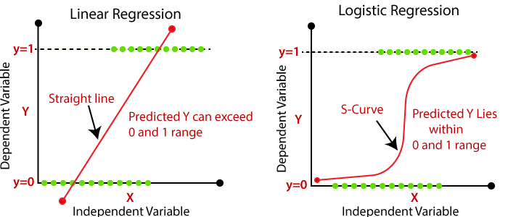
Linear regression v/s Logistic Regression

Slide 34

Logistic Regression
When the task is binary classification, we can set the target to the probability that a particular label is obtained
To make regression a binary classification task:
Predict a probability
If the estimated probability > 50%, predict that the instance is in the positive class, labeled “1”,
and otherwise predict that it belongs to the negative class, labeled “0”.
How to predict the probability?
Use a sigmoid function

Slide 35
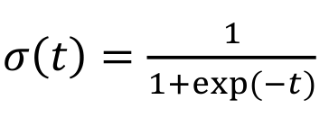
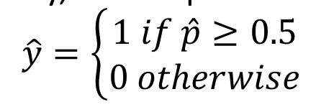
Equation behind Logistic Regression
Logistic or Sigmoid Function
Takes an input in (−∞, ∞) and returns a value between 0 and 1
‘t’ is like regular regression (t = y^ = mx^ + c)
After estimating probability, class is predicted as:
The sigmoid function is such that 𝜎 (𝑡) ≥ 0.5 when 𝑡 is positive
• When y^≥ 0, the class label is 1, else 0

Slide 36
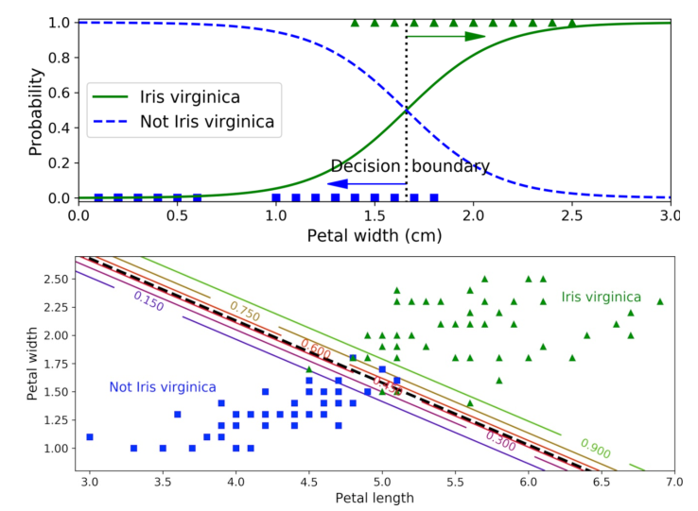
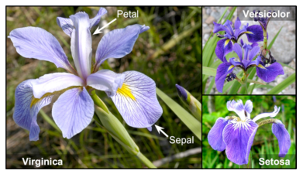
Example of Logistic Regression

Slide 38
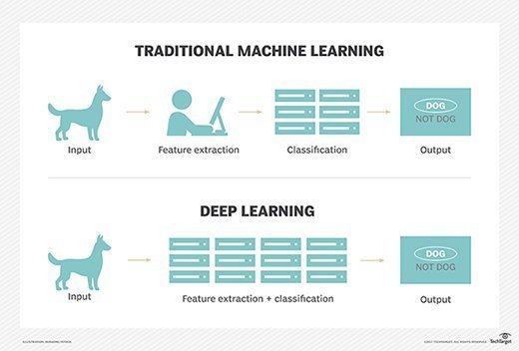
Machine Learning v/s Deep Learning

